Slide 1
Week6 Activities
Search Win_2022 for venerability
Tevin Herath

Slide 2
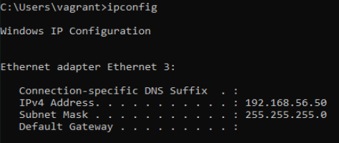
Search using Nmap
Steps:
Find my IP Address:
Command: ipconfig

Slide 3
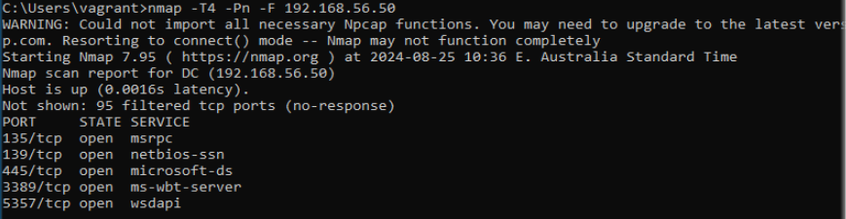
Search using Nmap (Cont.)
Install Namp and execute the following command:
nmap -T4 -Pn -F 192.168.56.50

Slide 4
Scan using wafw00f
Install wafw00f:
Pip install wafw00f
Scan using wafw00f:
Wafw00f 192.168.56.50

Slide 5
Nessus Scan
Setup Nessus Scan
Start Scanning

Slide 6
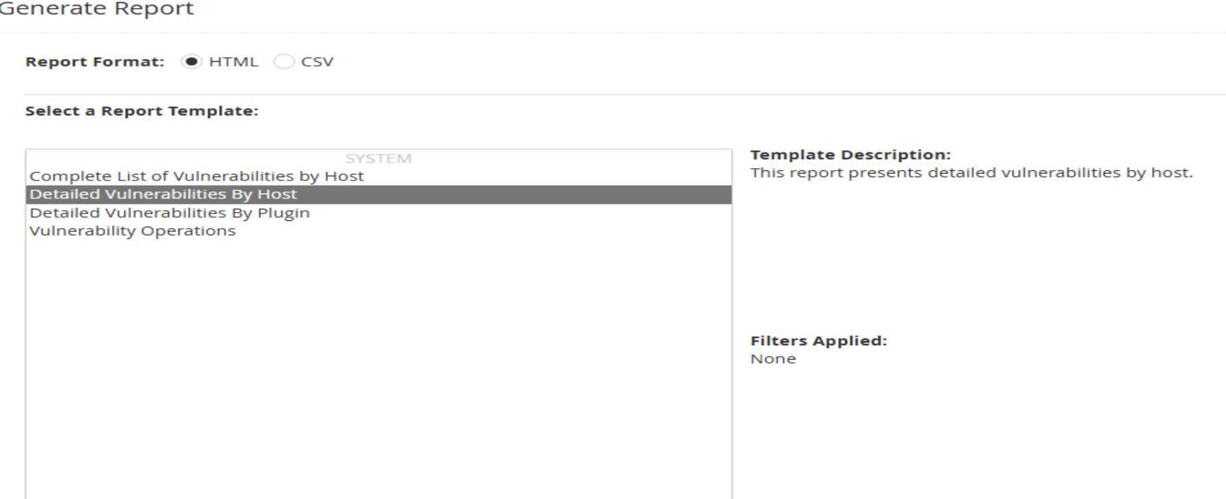
Nessus Scan – Report generation

